Slide 1

“TO - DO LIST”
Task - 3

Slide 2

TO-DO LIST
A to-do list, often referred to as a task list or checklist, is a tool that helps individuals organize and manage their tasks, responsibilities, and activities.
▪
Naan Mudhalvan id
Name
Batch
au421320104002
Afreena A
SKCET-4
au421320104004
Ashiba begam M
SKCET-4
au421320104009
Durgalakshmi V
SKCET-4
au421320104037
Sarulatha S
SKCET-4
au421320104041
Sharmila B
SKCET-4

Slide 3

PURPOSE
Task Management: To-do lists allow you to list and prioritize tasks, helping you manage your time and efforts effectively.
Organization: They help you stay organized by categorizing tasks, setting deadlines, and providing a clear overview of what needs to be accomplished.
Prioritization: You can assign priorities to tasks, such as "high," "medium," or "low," to ensure that important tasks are addressed first.
Time Management: To-do lists can include estimated time frames for completing each task, helping you allocate your time efficiently.
Tracking Progress: They enable you to track your progress by marking completed tasks and visualizing your accomplishments.

Slide 4
SOFTWARE REQUIREMENTS FOR ECOME
Node.js and npm (Node Package Manager): You'll need Node.js and npm to set up and manage your React project. You can download them from the official website: Node.js.
Code Editor: You'll need a code editor to write and edit your React code. Popular choices include Visual Studio Code, Sublime Text, or Atom.
React Developer Tools (Browser Extension): This is a browser extension for debugging and inspecting React components. It's available for Chrome and Firefox and can be installed from the respective browser extension stores.
Command Line Interface (CLI): You can use your system's command-line interface to create and manage your React project. You'll need a terminal or command prompt.

Slide 5
HARDWARE REQUIREMENTS
Server(s): Determine the number of servers needed based on the expected traffic and load.
Processor (CPU): Multi-core processors are often recommended for better performance.
Random Access Memory (RAM): Ensure that the server has enough RAM to handle the website's operations efficiently.
Storage: Select high-speed and reliable storage solutions, such as solid-state drives (SSDs) or redundant array of independent disks (RAID), to ensure fast data access.
Networking Equipment: Utilize high-speed networking equipment, such as routers, switches, and firewalls, to manage network traffic and ensure the security of the website and user data.

Slide 6
FUNCTIONAL REQUIREMENTS
User Registration and Authentication: Users should be able to create accounts and log in.Only authenticated users can create and manage their to-do lists.
Create Tasks: Users can add new tasks to their to-do list. Each task should have a title, description, due date, and optional priority.
List Tasks : Users should be able to view their list of tasks. Tasks should be organized by categories or projects.
Edit and Update Tasks : Users can edit task details, such as title, description, due date, and priority. The ability to mark tasks as completed or uncompleted.
Delete Tasks : Users can delete tasks from their to-do list.

Slide 7
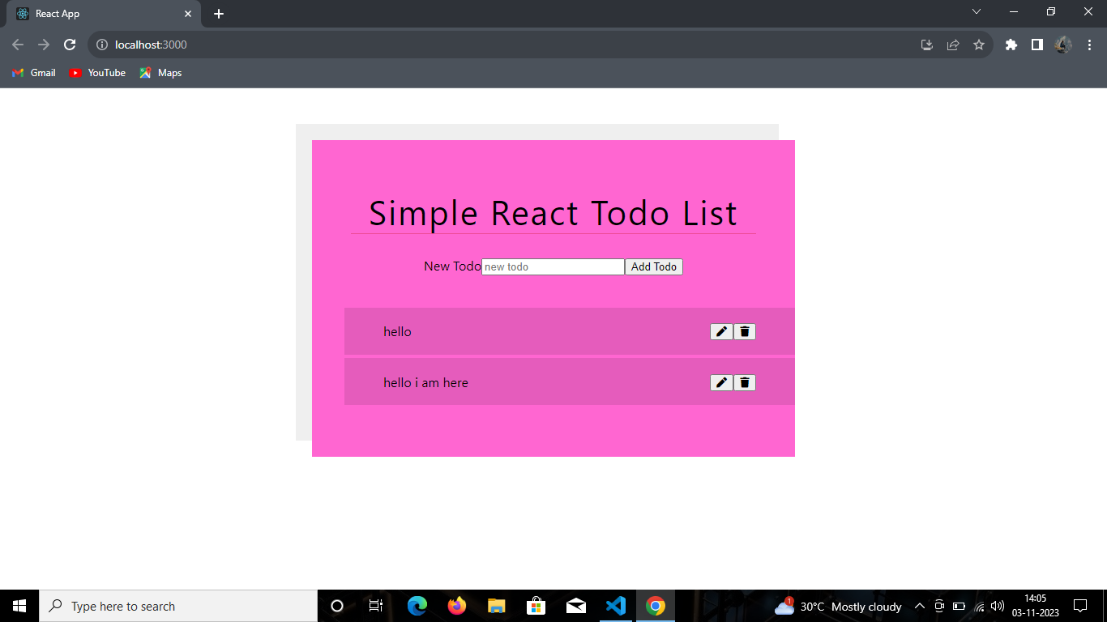
Output

Slide 8

Submission Github
Github Link:
https://github.com/Durgalakshmi2002/Naan-Mudhalvan.git

Slide 9


